Slide 1
Job Portal

Slide 2
OverView
Job Portal is Developed for Creating an Interactive job Vacancy Portal for Candidates.
In the world people are trying to get all things on the desk without wasting time , now-a-days technology is spreading very fast.

Slide 3
Introduction
This Job Portal is a Organization , display jobs /ads according to their requirements.
The people can view the post they can find different kinds of jobs and informations in here.
The companies will check the CV and they can call the candidate for an interview.

Slide 4
Features
Job Seeker
Job Provider(Company)
Job Search
Job Provider(Company): The company can add/delete/post/modify the job post.
Job Seeker: This will provide user to sign-up with details like name/ phone/create password then user account will be generated in database.
Then he/she can search for job using type of job/salary/location. Then they can apply job accordingly

Slide 5
Purpose
The purpose of this website is to provide a good job opportunities , better platform for finding a right and satisfactory job according to their study qualification.

Slide 6
Tools & Technology
PHP
XAMPP SERVER
HTML
CSS
MYSQL
JAVASCRIPT

Slide 7
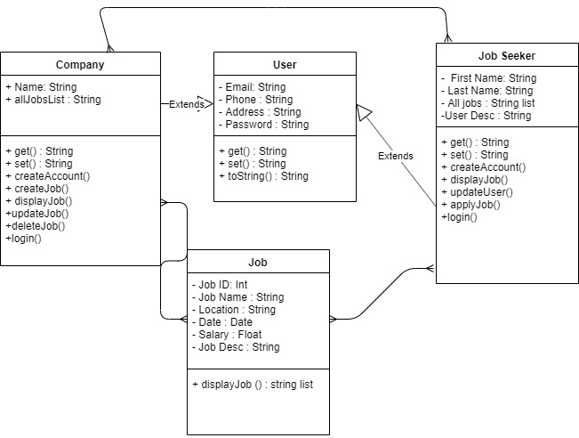
Class-Diagram

Slide 8
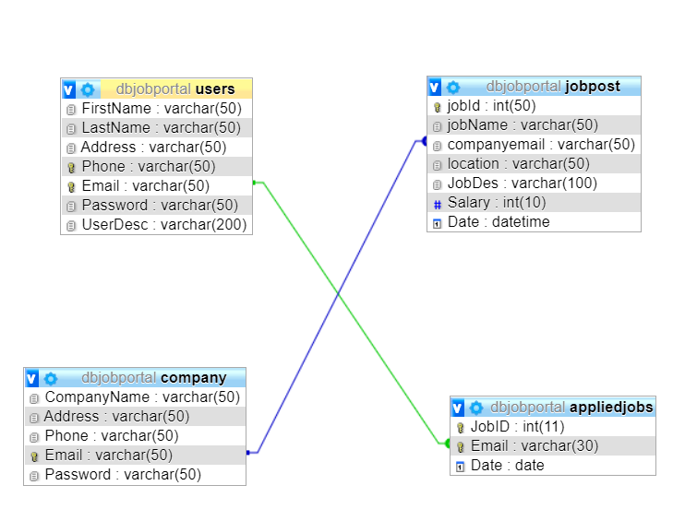
Database

Slide 9
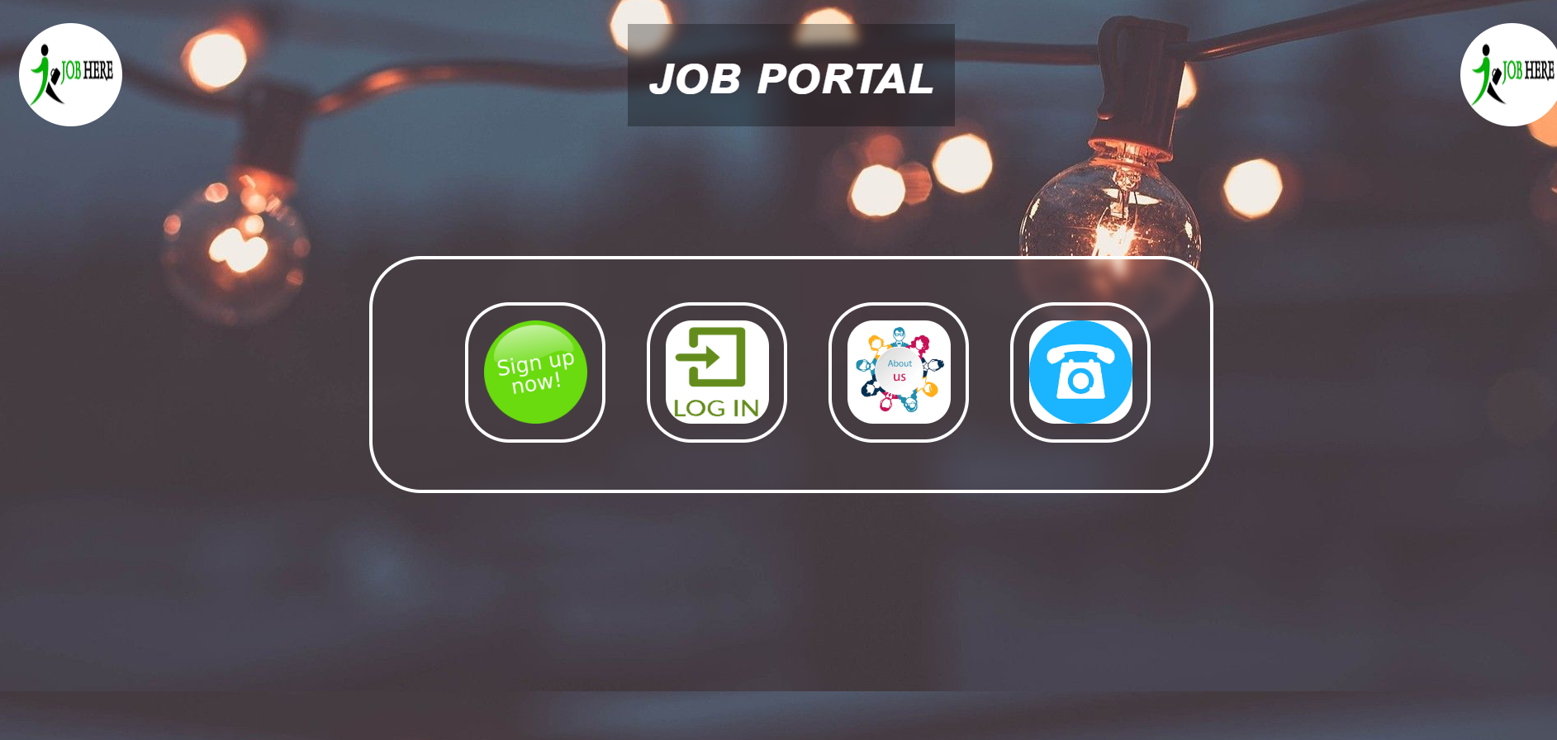
Home-Screen

Slide 10
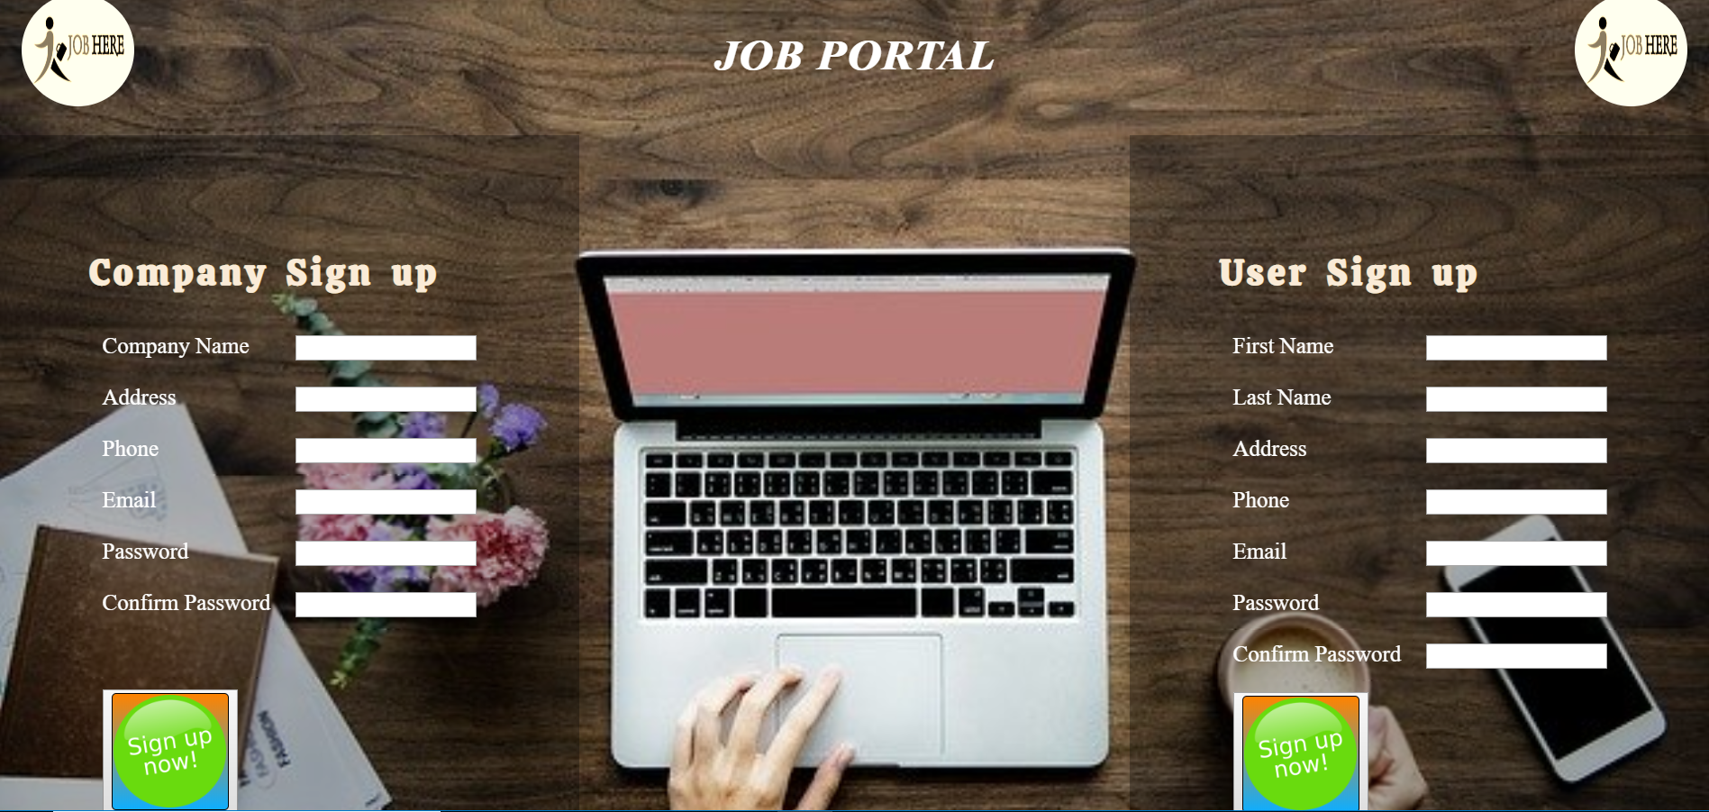
Signup page

Slide 11
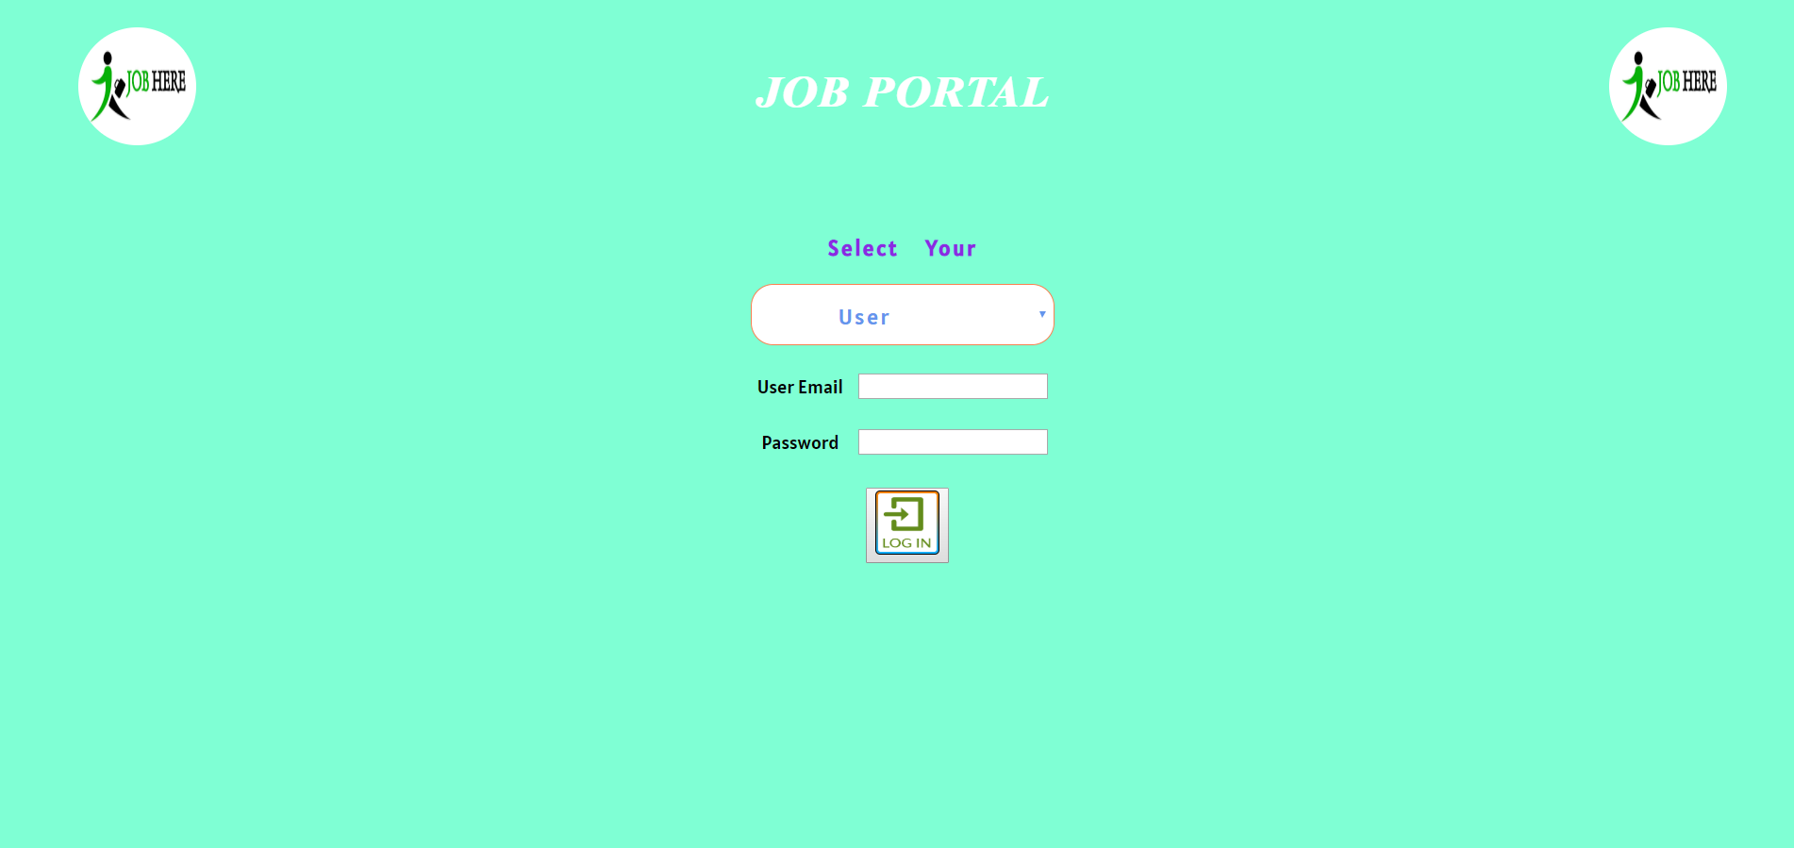
Login Page

Slide 12
Future updates
Update button for company
Company and User can communicate with each other

Slide 13
Thank you
Project Advisor: Mr. Mohamed Zeroug
Project Team:
Hao Han
Gaurav Kumar
Ramya Jupaka

